Slide 1
Title: Hackable: 3 VulnHub Walkthrough
Solved by : Omar Abdelmohsen & Mohamed Nabil

Slide 2
Introduction
Description: Hackable: 3 is a vulnerable virtual machine on VulnHub designed to test penetration testers
Goal: Gain root access through multiple security layers (enumeration, steganography, port knocking, brute force, and privilege escalation).

Slide 3
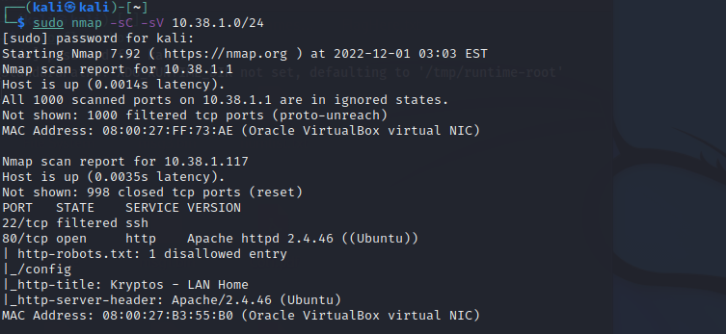
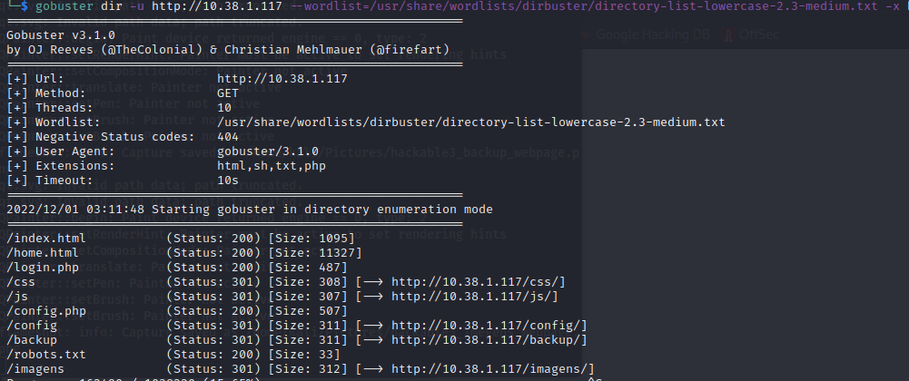
Initial Reconnaissance
Tools Used: Nmap, Gobuster/Dirbuster
Steps:
Identify open services.
Key discovery: SSH is closed,
port knocking is required, username “
jubiscleudo" found in the source code.
Network Scanning
Our IP address is 10.38.1.117

Slide 4

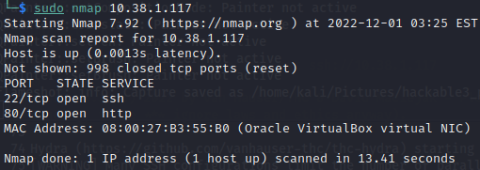
Port Knocking
Discovery:
Concept: Port knocking is a security technique
where a sequence of network requests must be made to specific ports to open a service, like SSH.
Process:Found port knocking sequence hidden in text files like 1.txt and 2.txt using base64 and brainf**k decoders.
Used Knock tool to knock on the correct sequence of ports ( 10000, 4444, 65535) to open the SSH port..

Slide 5
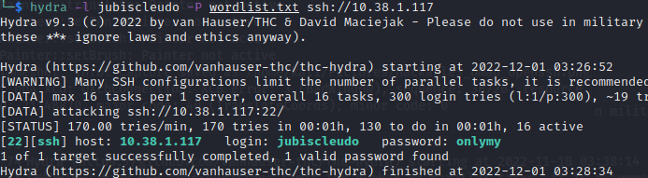
SSH Brute Force
Tools used:Hydra
Process:
Discovered the username jubiscleudo.
Used Hydra with a wordlist found on the machine to brute force the SSH password.
Successfully logged into the machine using SSH with the credentials found.

Slide 6
Enumeration Inside the System
Process:
Once inside via SSH, listed directories and files, finding hidden configurations.
Discovered backup files with user credentials for hackable_3.
Used these credentials to switch user and elevate privileges
ssh jubiscleudo@10.38.1.117
id
ls -la
cat .user.txt

Slide 7
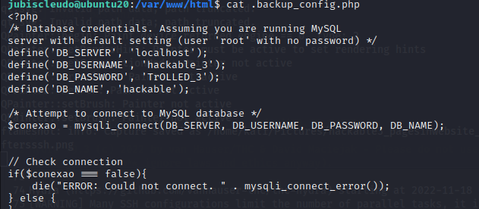
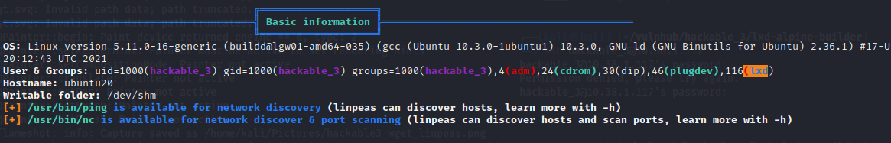
Privilege Escalation Using LXD
Tools used: LinPeas, LXD container exploit
Process: Ran LinPeas to identify vulnerabilities in the system.
Noticed the user belonged to the LXD group, which allowed exploiting a known vulnerability inLXD
.Imported a container, mounted it to root, and gained root access.

Slide 8
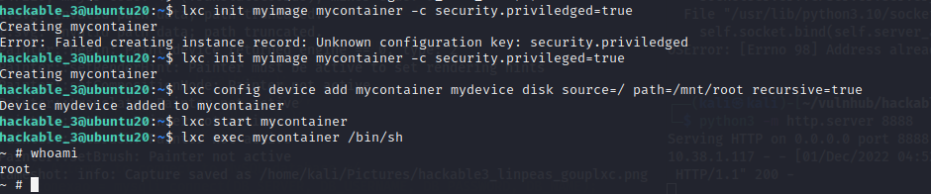
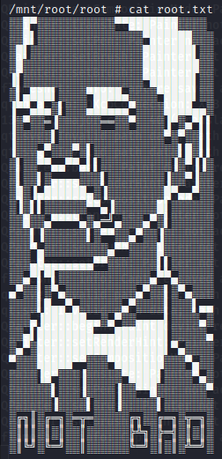
Root Access and Flag Capture
Process:
With root access, searched the system for the final flag.
Located and read the root flag to complete the challenge.
Ensured all steps were documented for reporting purposes.

Slide 9
Conclusion
Summary: Successfully gained root access through a combination of enumeration, port knocking, SSH brute-forcing, and exploiting container vulnerabilities.
Key Learnings: Importance of strong password policies, avoiding misconfigurations like port knocking, and keeping software like LXD updated to avoid privilege escalation vulnerabilities.

